Slide 1

Futurense
Democratizing Tech Talent to deliver impact at scale

Slide 2
Healthcare-MiniProject
Presented by:
J. Dheeraj Varma
EMPID:FT742
FF22

Slide 3
Brief Description :The healthcare case study focuses on developing an efficient data management system for a healthcare organization. It involves creating tables for addresses, claims, diseases, insurance, medications, patients, pharmacies, prescriptions, and treatments. The goal is to gain different insights and optimizing the data retrieval,analysis, improving overall performance and facilitating better patient care.
Business Problem:The healthcare organization is struggling with inefficient data management, resulting in challenges such as difficulty in retrieving patient information, insurance claims processing, and medication tracking. This leads to delays in providing timely and accurate healthcare services, impacting patient care and operational efficiency. The business problem revolves around the need for optimized data management system to address these challenges and improve overall healthcare service delivery.
Solution Approach: 1)Database Design
2)Table Creation
3)Data Insertion
4)Data Retrieval and Analysis
5)Query Optimization

Slide 4
Flow of the project
1. Database Design: Analyze the requirements of the healthcare case study and design an appropriate database schema using SQL. Create tables for Address, Claim, Contain, Disease, InsuranceCompany, InsurancePlan, Keep, Medicine, Patient, Person, Pharmacy, Prescription, and Treatment.
2. Table Creation: Use SQL CREATE TABLE statements to create the tables, specifying the appropriate columns, data types, and constraints for each table. Ensure the relationships between tables are properly defined using primary and foreign keys.
3. Data Insertion: Use SQL INSERT INTO statements to populate the tables with sample data. Input relevant information into each table, such as addresses, insurance claims, medications, patient details, pharmacy information, prescriptions, and treatment records.
4. Data Retrieval and Analysis: Utilize SQL SELECT statements to retrieve and analyze data from the tables. Write queries to extract information such as patient addresses, insurance claim details, disease records, medication information, treatment plans, and pharmacy details.
5. Query Optimization: Optimize the SQL queries for improved performance .Ensure proper table joins, and consider query optimization techniques such as using appropriate join types (e.g., INNER JOIN, LEFT JOIN) as necessary.

Slide 5

Tools and Technologies Used:

Slide 6
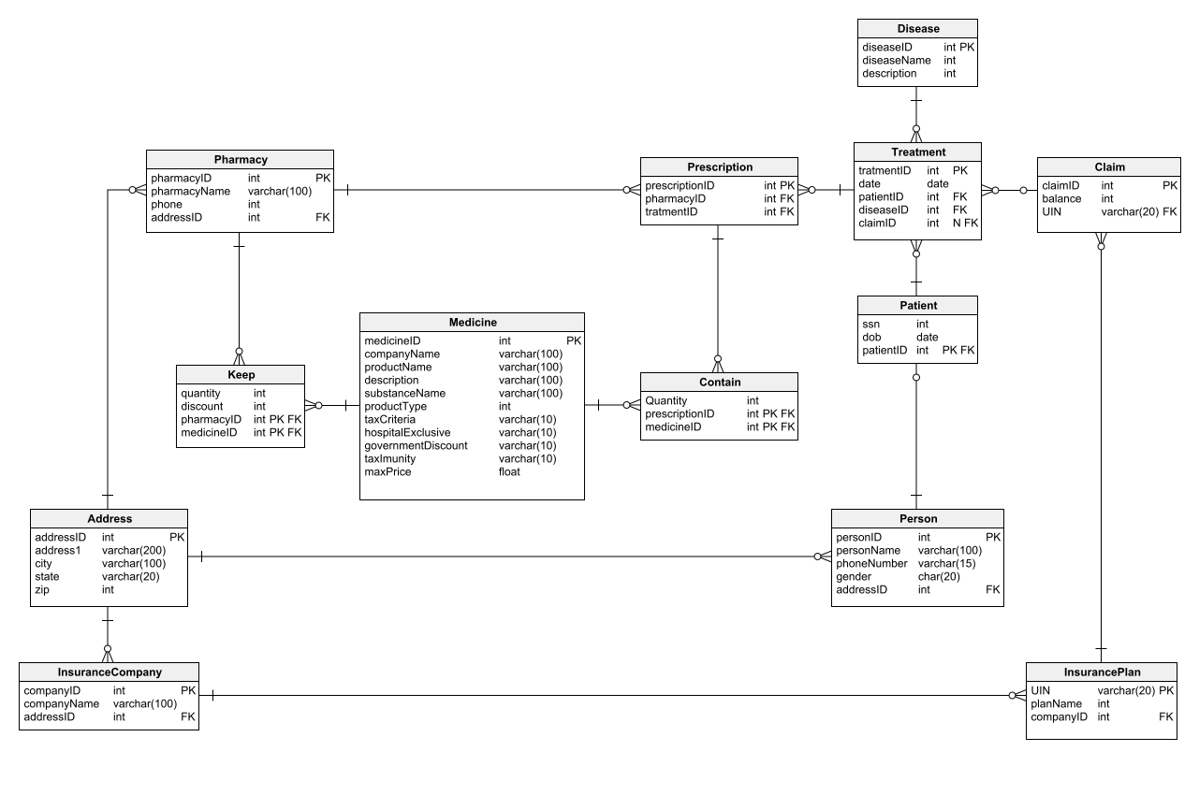
ER Diagram:

Slide 7
Optimizations and Best Practices Used:
1) Common Table Expression
2) Joins
3) Efficient Subqueries and reducing the correlated queries
4) Indexes
5) Stored Routines

Slide 8
Headline Statistics :
Average Execution Time = 27ms
Lines of Codes (LoC/KLoC) = 24
Total number of functions = 2
Number of built-in functions used = 2
Number of user-defined functions used = 0
Avg. number of lines per function = 24
No. of comments =5
IDE/Editor used = MYSQL workbench
Plugins used = None
Function/Complexity breakdown:
Simple Implementations: Basic tasks like counting.
Intermediate Implementations: Using IF Exists
Complex Implementations: Using Triggers instead of stored procedures.

Slide 9
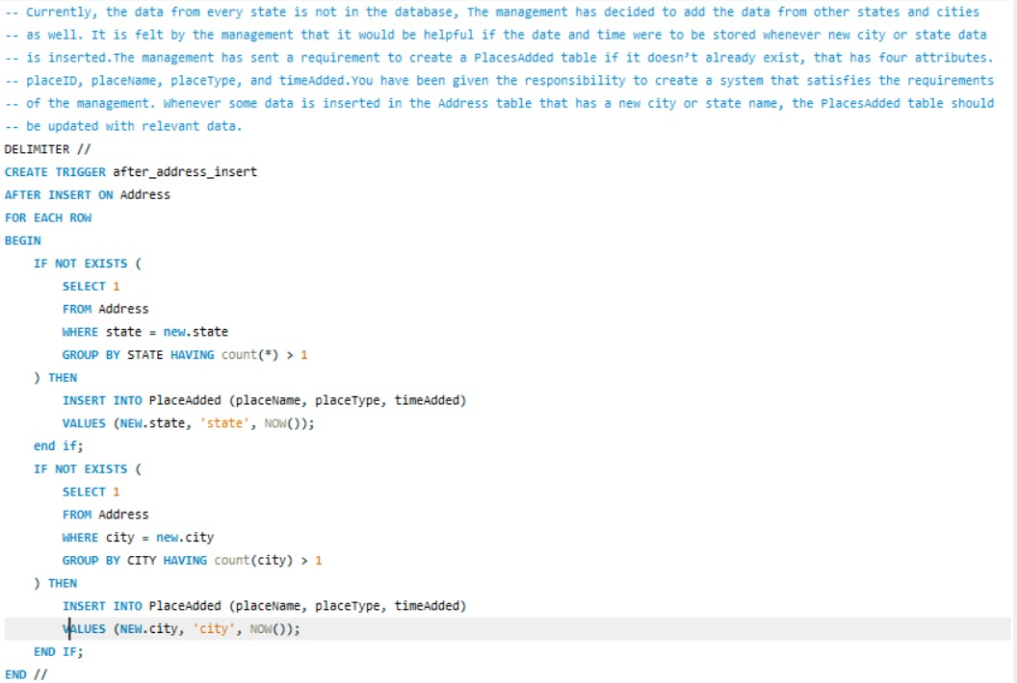
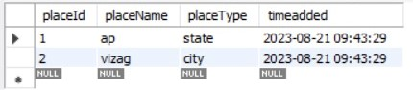
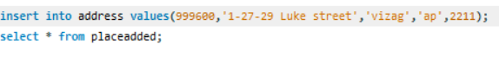
TRIGGER

Slide 10
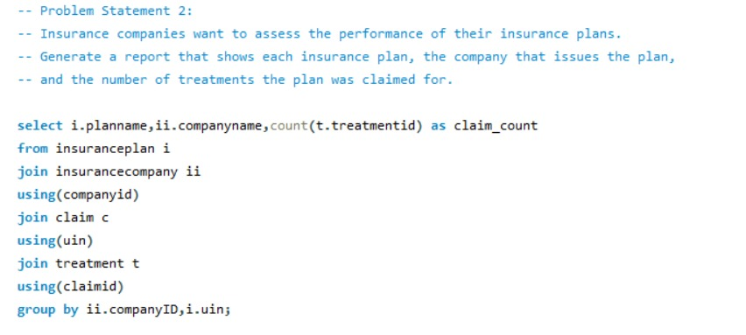
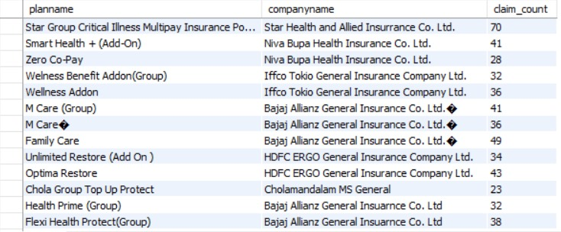
JOINS & GROUP BY

Slide 11
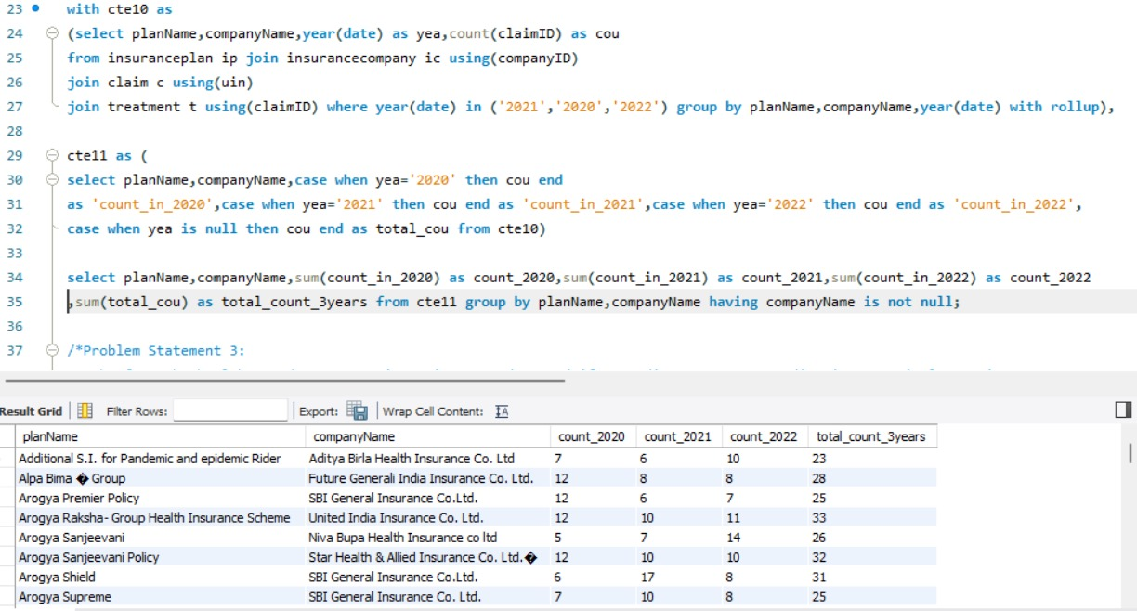
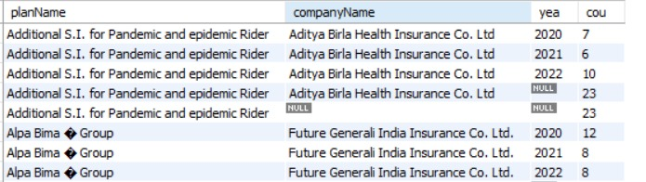
Problem Statement 2: Insurance companies want to evaluate the performance of different insurance plans they offer. Generate a report that shows each insurance plan, the company that issues the plan, and the number of treatments the plan was claimed for. The report would be more relevant if the data compares the performance for different years(2020, 2021 and 2022) and if the report also includes the total number of claims in the different years, as well as the total number of claims for each plan in all 3 years combined.
Roll Up

Slide 12
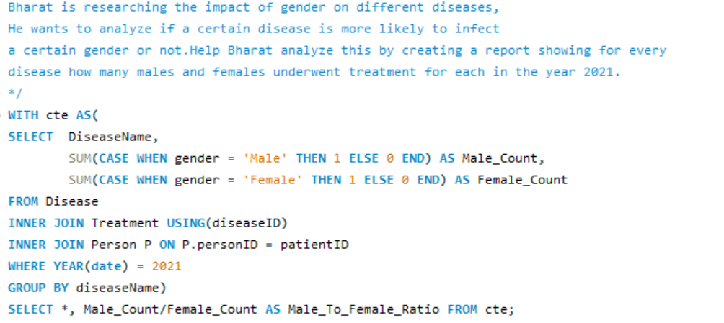
CTE & Sub Queries

Slide 13
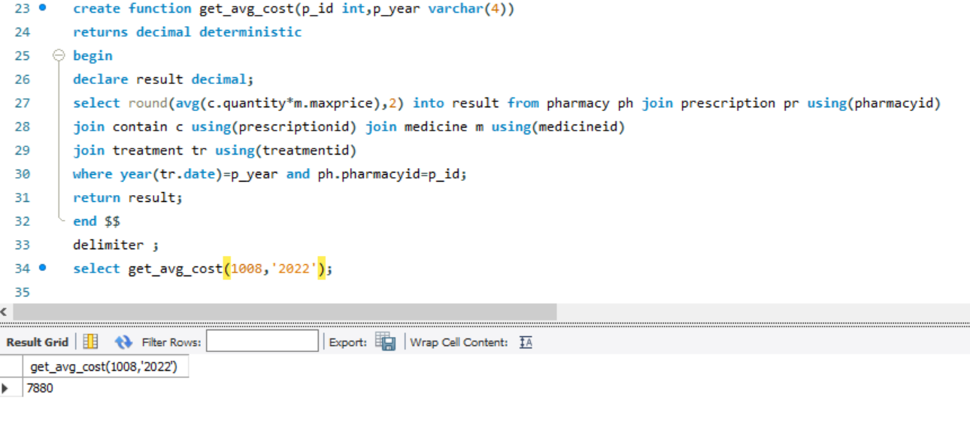
FUNCTION
The pharmacies are trying to estimate the average cost of all the prescribed medicines per prescription, for all the prescriptions they have prescribed in a particular year. Create a stored function that will return the required value when the pharmacyID and year are passed to it. Test the function with multiple values.

Slide 14
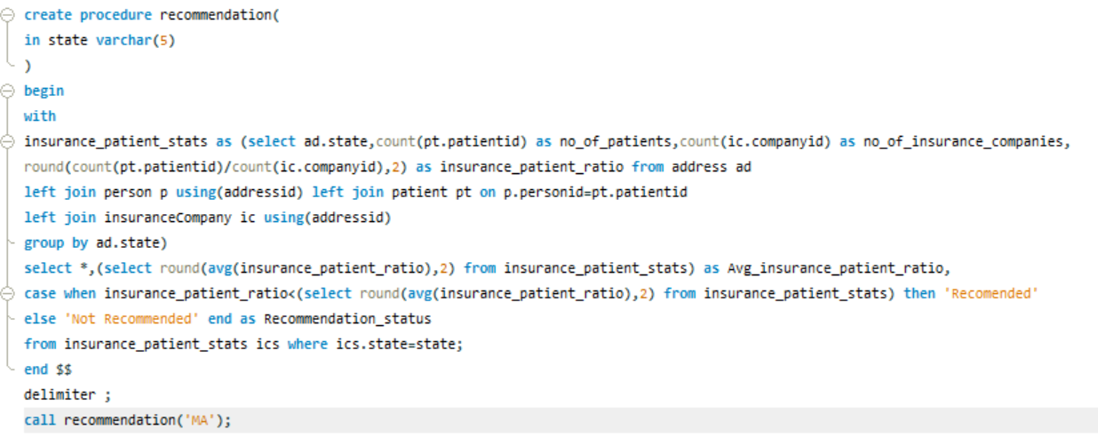
Problem Statement 3:Jacob, as a business strategist, wants to figure out if a state is appropriate for setting up an insurance company or not.Write a stored procedure that finds the num_patients, num_insurance_companies, and insurance_patient_ratio, the stored procedure should also find the avg_insurance_patient_ratio and if the insurance_patient_ratio of the given state is less than the avg_insurance_patient_ratio then it Recommendation section can have the value “Recommended” otherwise the value can be “Not Recommended”.
STORED PROCEDURE

Slide 15
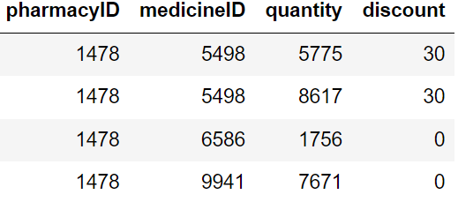
Roadblocks & Resolutions
From the sample figure, we can clearly see that there is redundant data that is present in the keep table.
This data is completely fine to an extent that for the same medicine there can be different discounts based on the stock and demand.
But still there are some redundancies where the same medicine in the pharmacy with the same discount is present.
There are different approaches to solve this problem and I have chosen an approach where I just added the quantities whenever pharmacy, medicine and discount is same then considering all the pharmacyID, medicineID, discount combined as the primary key.
We can also keep entire columns as a single primary key.

Slide 16
Thank You

